Slide 1
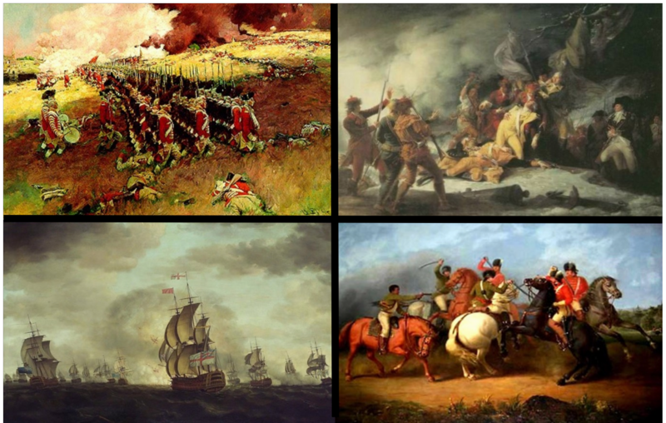
The Age of Revolution

Slide 2
Mercantilism Activity
Mr. Cook = King
5 Countries (Portugal, Spain, Netherlands, England, France)
Chips = Every time you trade 10 items you earn $10 more of your product
You can never trade all of one product
Red (Cinnamon) = $5
Blue Chips (Silk) = $4
Green Chips (Cloves) = $3
Black Chips (Pepper) = $2
White Chips (Salt)= $1
Notes:
I can come in at any time and take any items from the colonies
The American colonies start with more chips and all 3 items where the other countries start with one item
Or have the kids decide what is worth more
Slaves? Tallest kid in the class is the best slave b/c all the chips are on the top shelf

Slide 3
Revolution
Now that you have revolted against your King you need to develop your own government
Create a Classroom Constitution
10 Rules
Constitution cannot violate school rules
Constitution cannot override classroom assignments or exams
Constitution will be valid on 10/14/16
Must be ratified by everyone in the class
Notes:
The top 10 money earners will get to go early. All ties will be rounded up.

Slide 4
Activity Reaction
How did you feel about being taxed without any say in the matter?
Did anyone steal during the Mercantilism activity?
How did you feel about the price of your core product?
Did any country have an advantage? Disadvantage?
Were there any trade embargos (trade blocks)? Were there any monopolies?
When forming your new constitution and government was it organized?
Did anyone group or person take control during the formation of your government?
Did people form factions designed to undermine the new government?
Did everyone agree on all the constitution rules? Did anyone sign reluctantly?
Is it easy to start a government from scratch?

Slide 5
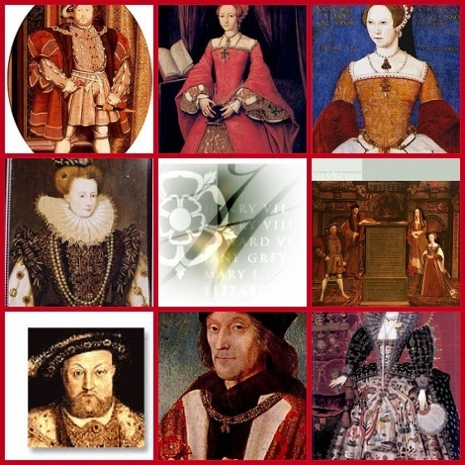
English Revolution
From 1485 to 1603 England was ruled by the Tudor dynasty
Parliament developed in England
Kings had all the power but still consulted parliament
  Kings contacted parliament to collect taxes
Henry VIII and Elizabeth I had relations with parliament

Slide 6

English Revolution
When Queen Elizabeth I dies it ends the Tudor dynasty
The monarchy is passed to the Stuarts from Scotland
  Not as skilled at dealing with Parliament as the Tudors
Parliament starts to challenge the power of the monarchy
James I clashed with Parliament saying that divine right decided the power of England

Slide 7
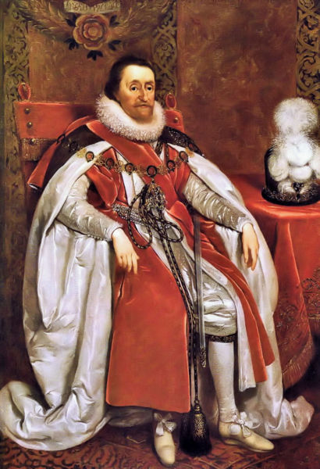
English Revolution
When Parliament asked James I why he needed so much tax money he dissolved it
James also faced a challenge from dissenters
  Protestants who differed with the Church of England
  King James called for a new translation of the Bible
    This is known as the King James version

Slide 8
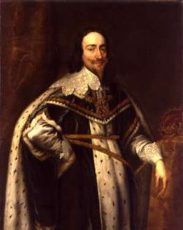
English Revolution
Charles I takes over for James I
Parliament rises again
Charles I goes to Parliament for taxes
  Parliament makes Charles sign a petition saying that kings cannot raise taxes without the consent of Parliament
  Also could not imprison someone without just cause

Slide 9
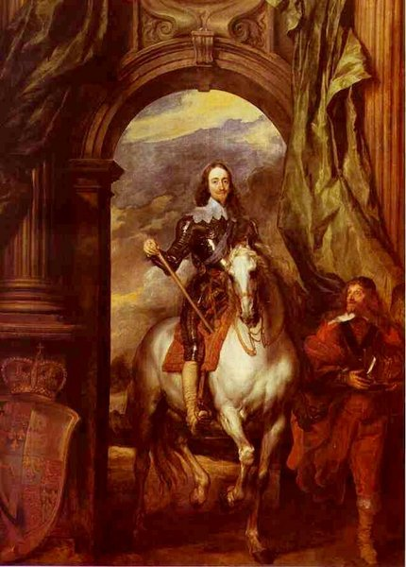
English Revolution
Charles I then dissolves the Parliament much like his father
  Gone for 11 years
Charles I made many enemies over this 11 years
In order to suppress a revolt he needed to raise taxes again
  Parliament forms again, but this time they revolt against Charles I

Slide 10
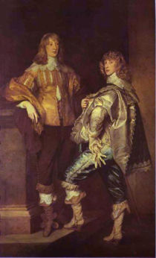
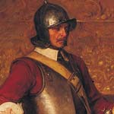
English Revolution
The English Civil War
  Cavaliers supported Charles I
    Usually rich nobles with long hair, well trained in dueling and warfare
    They expected a quick victory
  Roundheads supported Parliament
    Made up of country folk, Puritan clergy, manufacturers
  Oliver Cromwell
    Leader of the Roundheads

Slide 11
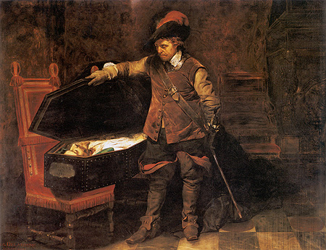
English Revolution
Cromwell - Skilled general
Cromwell’s Roundheads defeat the Cavaliers and capture Charles I
They put Charles I on trial
  Convicted of being a tyrant, traitor, murderer and public enemy
  Charles I was beheaded
  First time a ruler was tried and killed by his own people

Slide 12
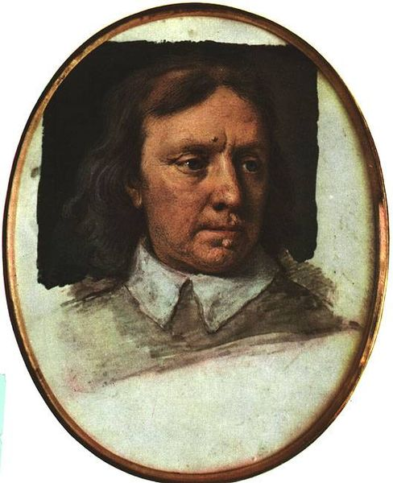
English Revolution
The Monarchy is abolished
England becomes a republic known as the Commonwealth
  Oliver Cromwell leads
Charles II – heir to the throne
  Attacks England from Ireland and Scotland
  Cromwell crushes the uprising and takes harsh measures against the Irish Catholic
  Parliament passes a law banishing all Catholics to the barren part of Ireland – If disobeyed they could be killed on sight

Slide 13
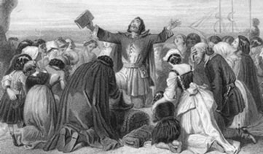
English Revolution
Puritans take over socially
  Banned profane behavior on Sundays
  Theatres were seen as lewd and are closed
  Banned lewd dancing, taverns and gambling
Puritans expected everyone to read the Bible so everyone had to go to school

Slide 14
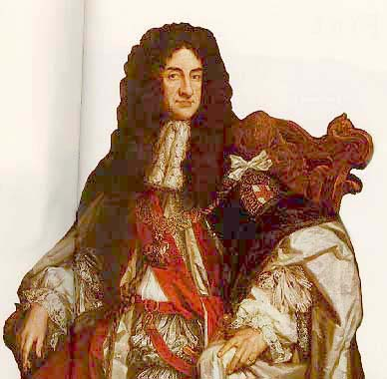
English Revolution
Oliver Cromwell Dies in 1658
  Puritans lose their grip on England
  The Parliament asks Charles II to return to England ending his exile
  The Monarchy is restored
Charles II was popular
  Reopens theatres and taverns
  Reinstated the Church of England but allowed other forms or Christianity to exist

Slide 15
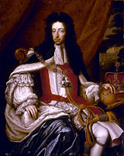
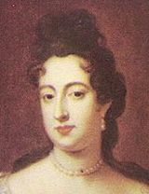
English Revolution
James II takes over when Charles II dies
  James II is openly Catholic
Parliament was scared that James II would make Catholicism the official religion again
  They invited Mary (James’ daughter) and her husband William III to take the thrown
    They were Protestant
    James II flees to France
    This is known as the Glorious Revolution

Slide 16
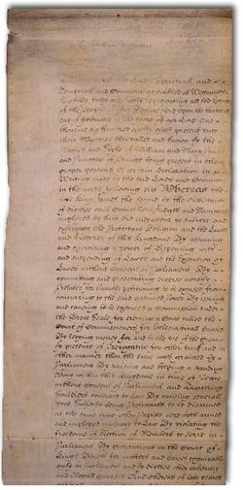
English Revolution
Parliament puts William & Mary into power and passes the English Bill of Rights - 1689
  Stated that Parliament had the authority over the Monarchy
  Gave the House of Commons the “Power of the Purse”
  Also banned any Roman Catholic from claiming the English throne
  Trial by Jury
  No cruel or unusual punishment
  Habeas Corpus – No person can be held in prison without being charged with a crime

Slide 17
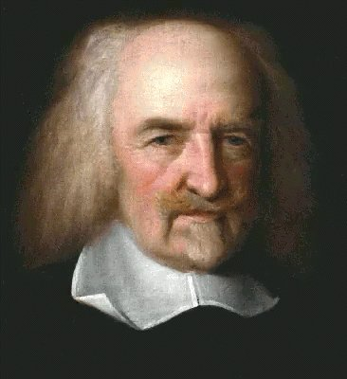
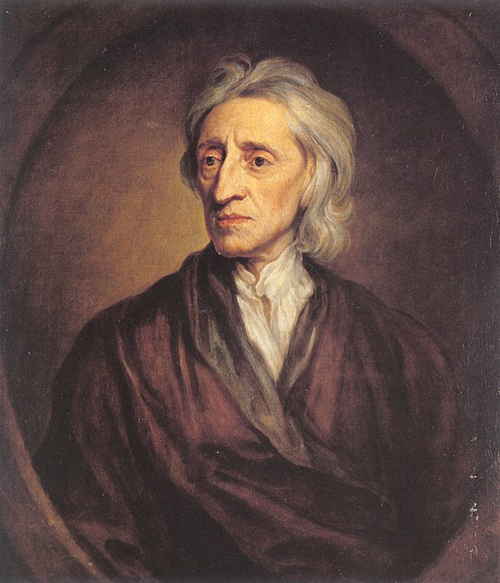
The Enlightenment
Through the use of reason, people and governments could solve every social, political, and economic problem
Thomas Hobbes
John Locke
  Both lived through the English Civil War
  Both came up with opposing views of human nature and government

Slide 18
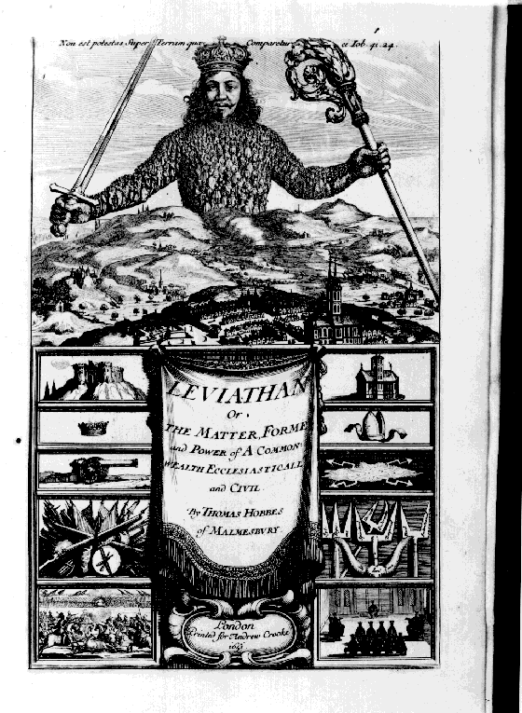
The Enlightenment
Hobbes
  Wrote Leviathan
  Argued that people were naturally cruel, greedy, selfish
  If they were not controlled they would fight, rob and oppress one another
  Life in a state of nature would be solitary, poor, nasty, brutish and short
  Argued people needed to enter into a social contract in which government used its power to protect the people from themselves
  Favored a Monarchy

Slide 19
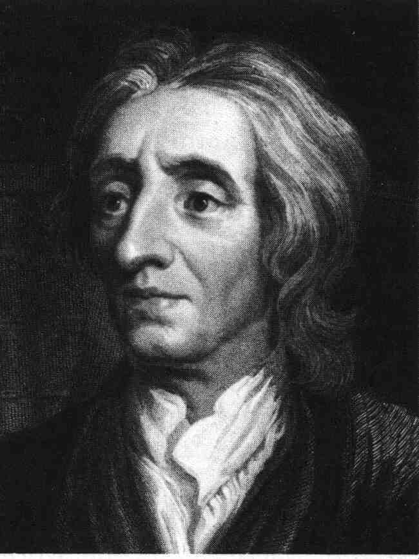
The Enlightenment
Locke
  People are reasonable, moral and good
  Natural rights – Life, liberty and property
  Wrote “Two Treaties of Government”
  People form governments to protect their natural rights
  Believed in limited government
  If a government violates your natural rights it is the people’s right to overthrow the government
  Favored Democracy

Slide 20
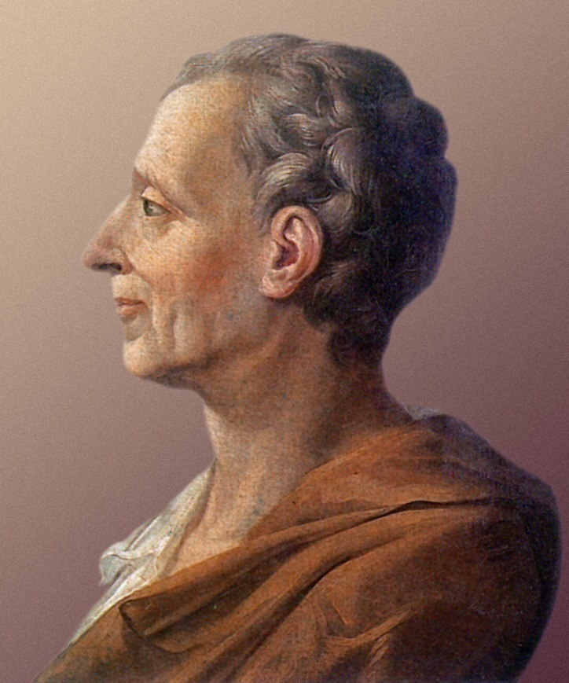
The Enlightenment
Montesquieu
  Wrote “The Spirit of the Laws”
  Openly criticized Monarchies
  Believed in separation of powers
  This helped prevent tyranny
  Preached in 3 branches of government – Executive, Legislative and Judicial
  Checks and Balances

Slide 21
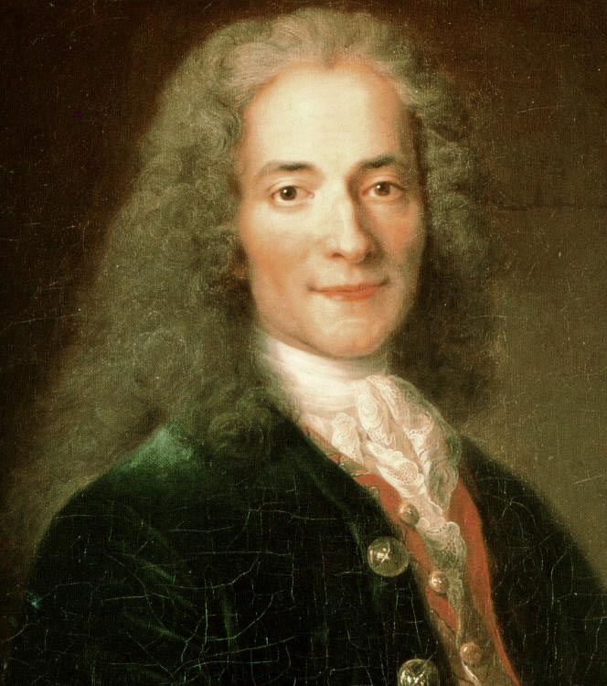
The Enlightenment
Philosophes – Lovers of wisdom
Voltaire – French Philosophe
Used biting wit as a weapon to expose the abuses of government
Targeted corrupt officials and aristocrats
Battled inequality, injustice and superstition
Detested the slave trade and religious prejudice
Offended the French government and Catholic Church
Imprisoned and finally forced into exile
Defended freedom of speech to the end

Slide 22

The Enlightenment
Denis Diderot
Took 25 years to write his 28 volume encyclopedia
Collected works of all leading Philosophes
Attacked slavery
Praised freedom of expression and education for all
Pope threatened to excommunicate any Roman Catholic who read it

Slide 23
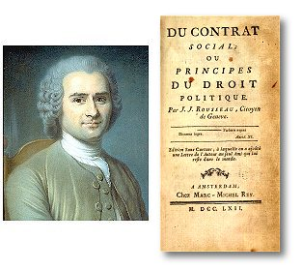
The Enlightenment
Jean-Jacques Rousseau
Believed that people were good much like Locke
Society corrupted people
Wrote “The Social Contract”
Hated political and economic oppression
Felt government should be limited and only around to prevent corruption of individuals

Slide 24
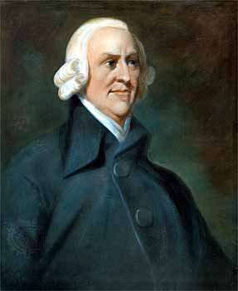
The Enlightenment
Physiocrats were enlightened thinkers that concentrated on economic policy
They hated Mercantilism
Believed in Laissez Faire
Business’ operate with minimal government interference
Free Trade or Open Market
Opposed tariffs and taxes on trade

Slide 25

The Enlightenment
Adam Smith
Wrote “The Wealth of Nations”
Supported Laissez Faire and believed in the free market
Invisible Hand
Believed that supply and demand would take care of the market

Slide 26
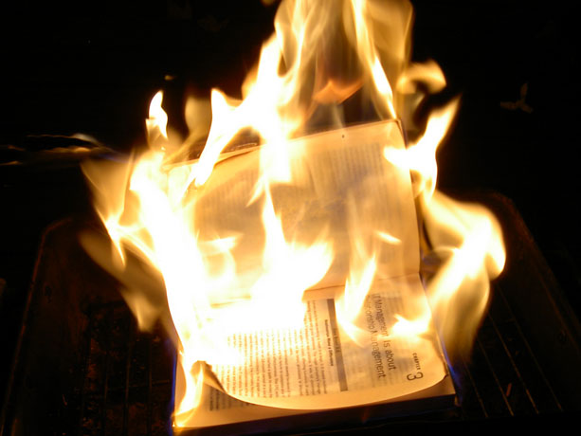
The Enlightenment
Monarchies and the Church opposed the Enlightenment
Censorship
  They banned Enlightenment books, burned them and imprisoned writers
  Enlightenment writers started to disguise their works in fiction
Salons
  New literature, art, science and philosophy was discussed at Salons

Slide 27
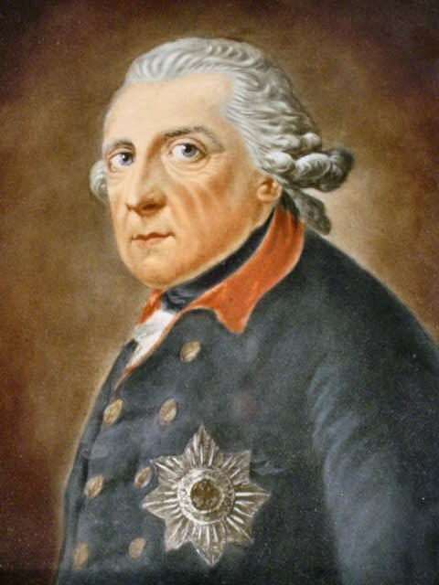
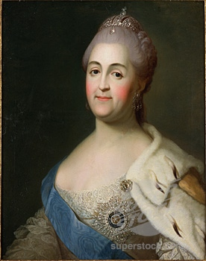
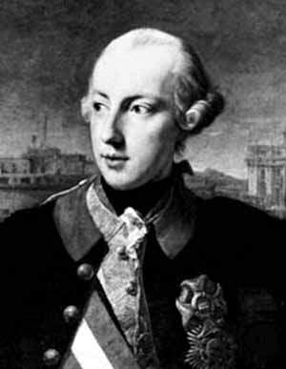
The Enlightenment
Enlightened Despots
  Rulers who accepted the ideas of the Enlightenment and used their position to spread those ideas
Frederick the Great
  King of Prussia 1740-1786
Catherine the Great
  Queen of Russia 1760’s
Joseph II
  King of Austria

Slide 28
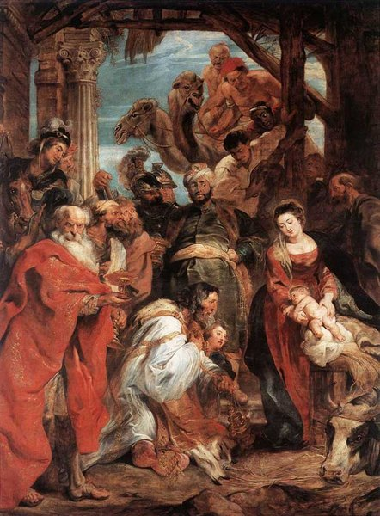
The Enlightenment
Trends in art
  Baroque paintings
    Huge, colorful and full of excitement
    Glorified grand events
  Rococo architecture
  Middle Class audiences grow
  Art and music had only been designed for the rich until this period of time
  The Novel was created

Slide 29
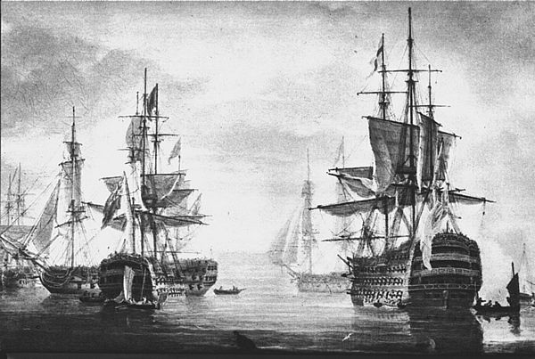
Britain’s Rise to Power
Britain develops the worlds strongest navy
  Because of this they did not need a large standing army
British economy booms
Britain unites with Scotland
  Stuart dynasty
Party system develops
  Tories and Whigs
Cabinet system
  Close advisors to the king or Prime Minister

Slide 30
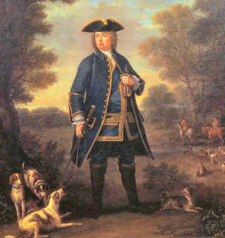
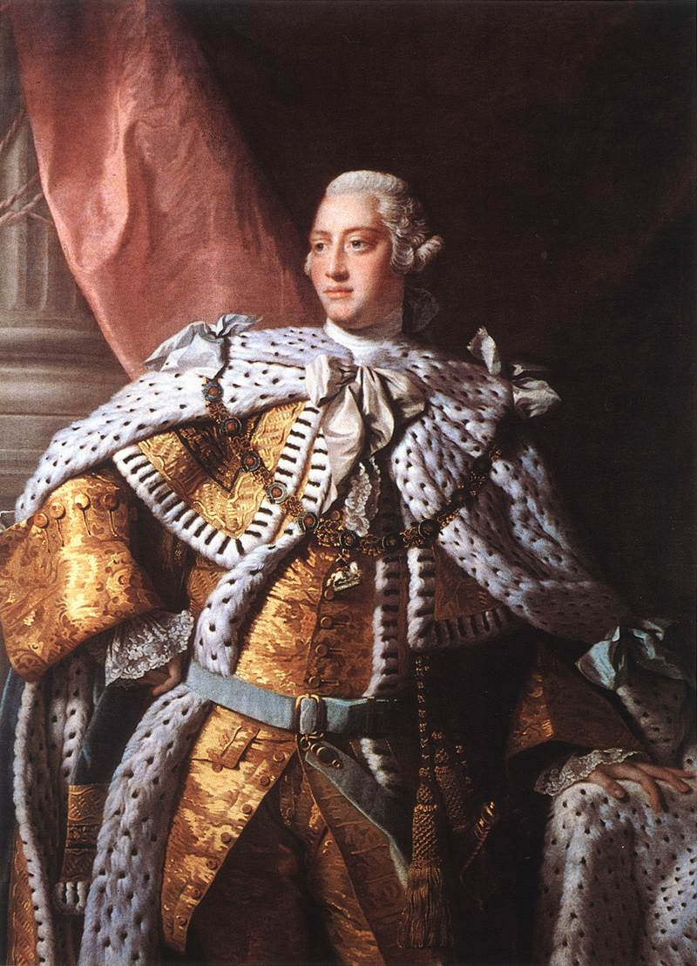
Britain’s Rise to Power
The Prime Minister
  Leader of the Majority party in Parliament
  Robert Walpole – 1st PM
George III
  Reasserts Royal Power
  Found seats in Parliament for his friends
  Then used his friends to regain the monarchy
  After the Seven Years War he told American Colonists that they would have to pay for their own defense
  Colonists revolt and fight Revolutionary War

Slide 31
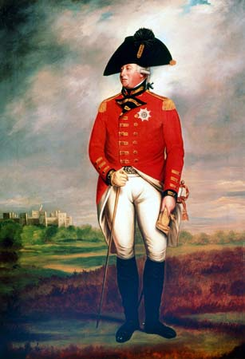
Britain’s Rise to Power
American’s win Revolutionary War and this discredits King George III
Parliament Rule is restored

Slide 32
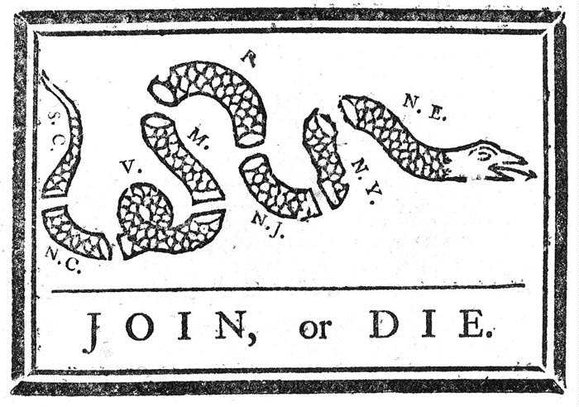
Birth of America
13 English Colonies
  Part of England’s empire
  England continued to place taxes and tariffs on the colonies
  “No taxation without representation” - No representatives in Parliament
  Boston Massacre
  Boston Tea Party
  Continental Army
    General George Washington

Slide 33
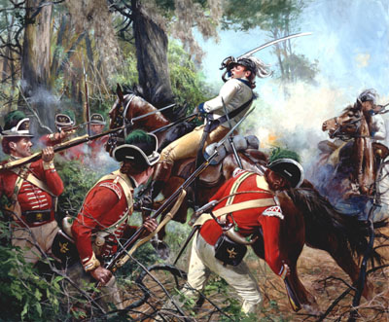
Birth of America
Declaring Independence
  Thomas Jefferson writes the “Declaration of Independence”
    Heavily influenced by John Locke
American Revolution
  America was getting destroyed early on
    1/3 of American Colonists were Loyalists
  French join the Colonist’s side
  Colonists force a British surrender at Yorktown

Slide 34
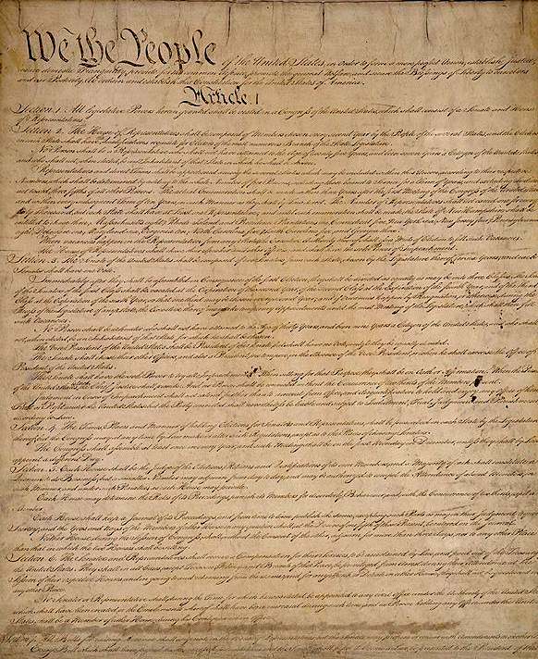
Birth of America
A New Constitution
  Enlightenment Ideas used to write the Constitution
1789 – Constitution becomes the law of the land

